Slide 1
Deep Dive into Astah Tutorial
ASU UGTA Nicole Garcia

Slide 2
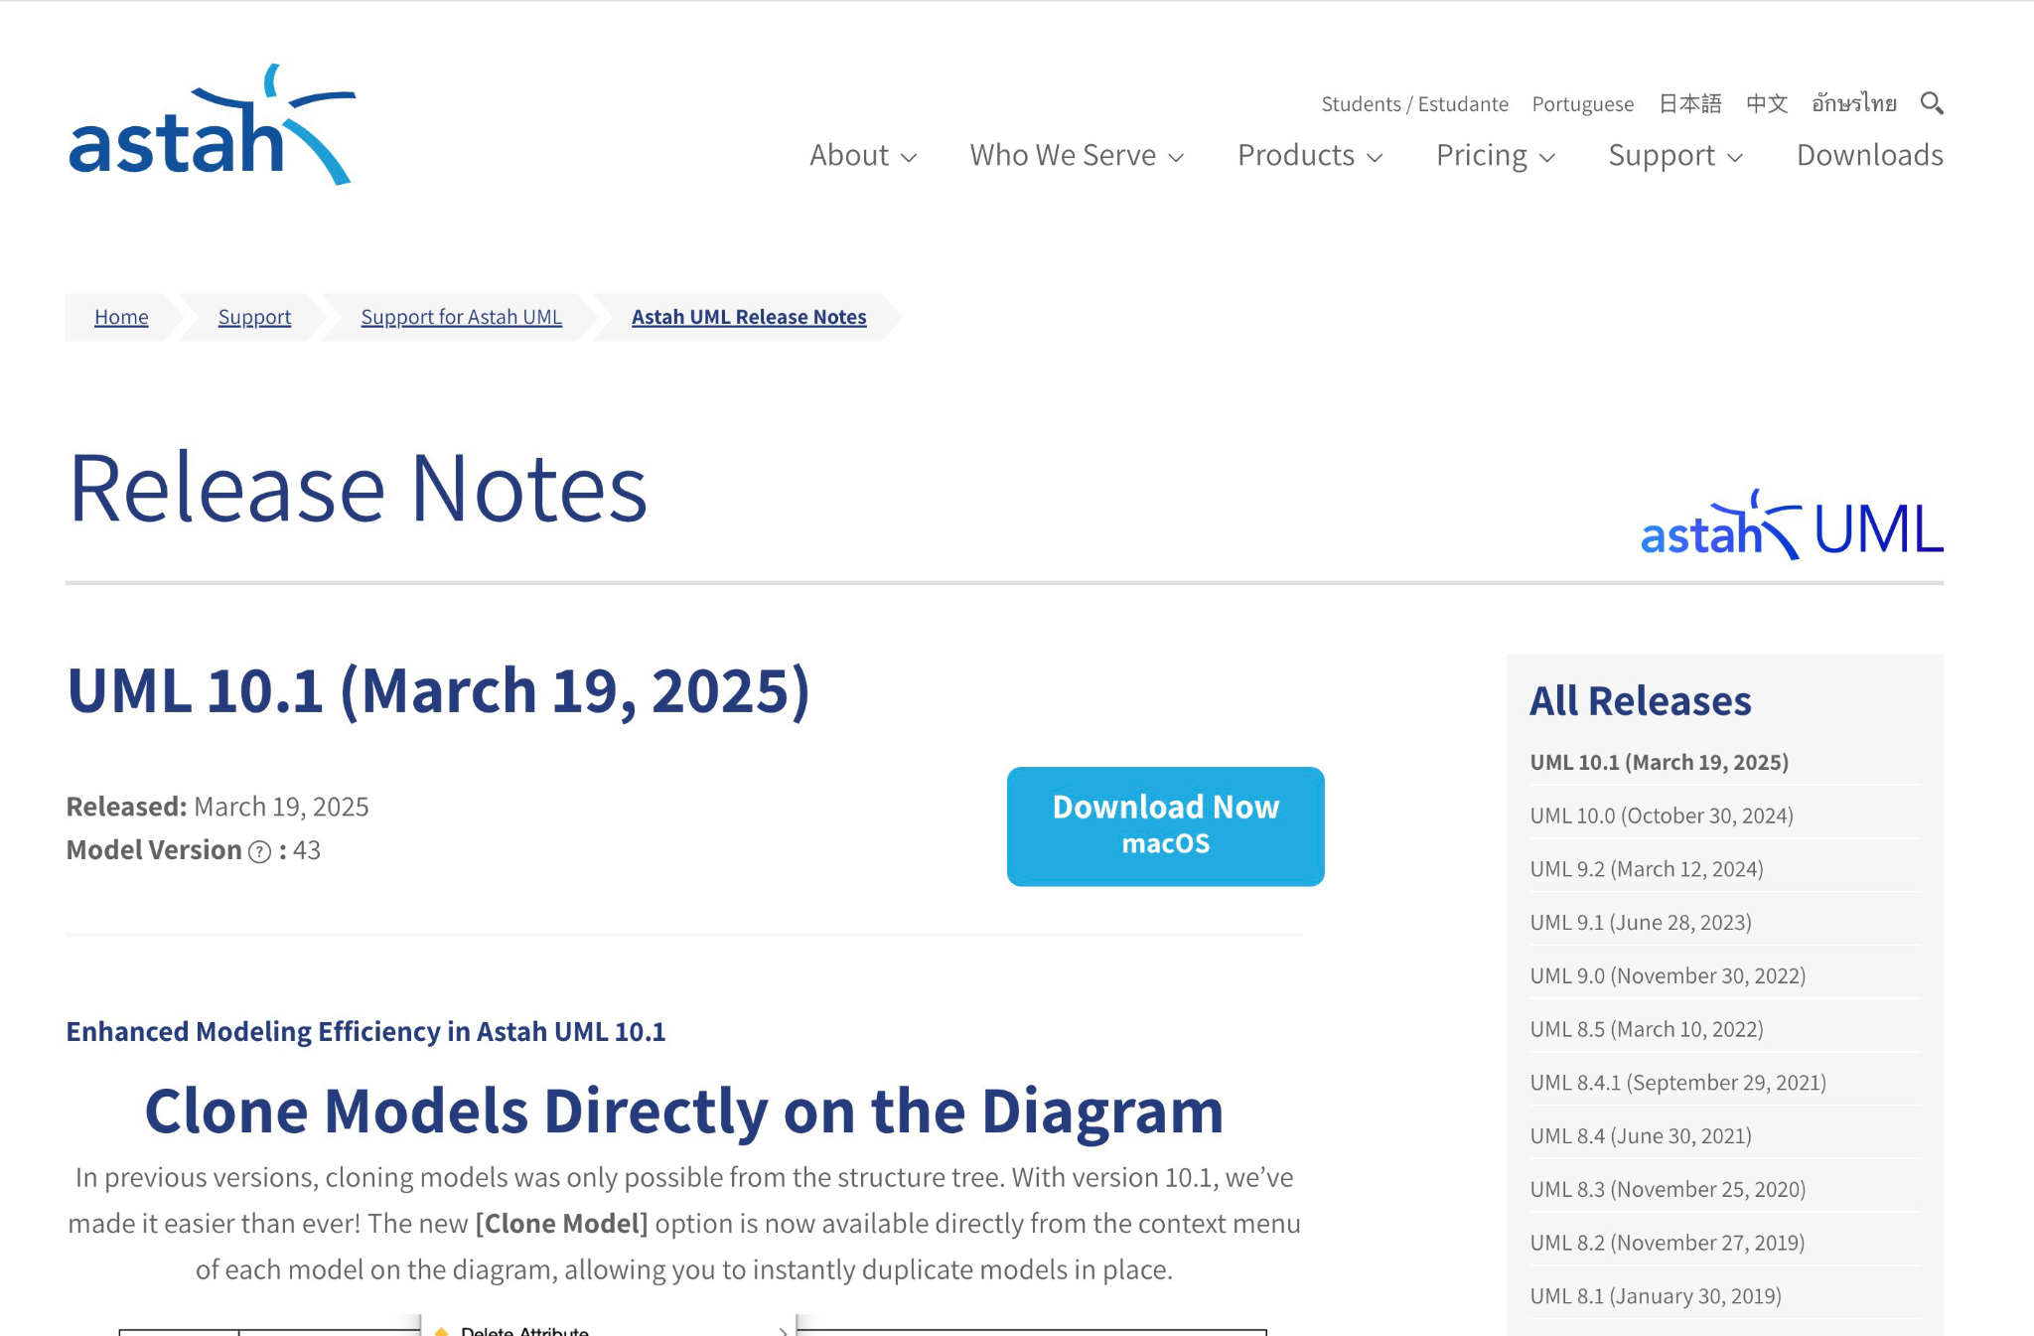
Downloading Astah
Go to the Astah download page https://astah.net/downloads/, and click on the download button according to your system to get started..

Slide 3
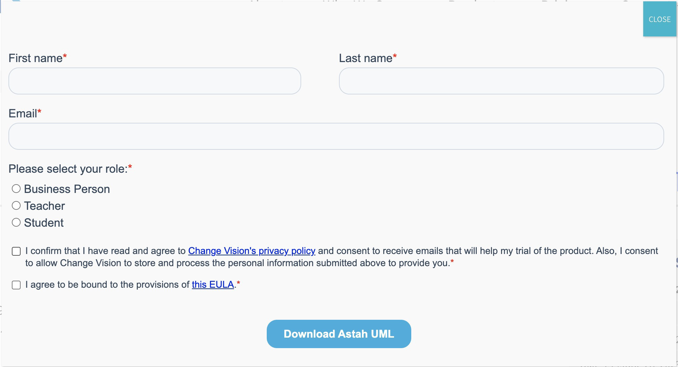
Downloading Astah
Next, enter your name and email address when prompted to start the download. There are a few versions you can choose from including Astah Professional and Astah UML. Choose the version according to your needs. I recommend choosing the Astah UML version to start with.

Slide 4

Activating student version of Astah
Astah offers a free license to students. To get this free student license you must fill out an application form on the downloads page. Go to this page (https://astah.net/products/free-student-license/) to get your free student license.
Once you have completed and submitted the free student license form the download will start. When the download is completed, follow the instructions for installing Astah.
There are more free trials that last around 20 to 40 days if you’d like to try those out. Since you are a student, I recommend applying for the free student license and using that.

Slide 5
Installing Astah
Windows: Run the .exe installer and follow the setup instructions.
Mac: Download the .dmg file, open it, Follow the installation instructions provided. You may need to drag and drop the Astah application into the Applications folder.
Linux: Extract the .zip file and run the astah executable.

Slide 6
Initial Astah Setup
Launch Astah and configure:
Workspace location
Preferred language
UI themes and layout preferences
You can also install plugins for more functionality.

Slide 7
Key Features and Types of Diagrams in Astah
UML Diagrams
Class Diagram: Models object-oriented structures.
Sequence Diagram: Represents interactions between objects.
Use Case Diagram: Defines system functionality from a user’s perspective.
State Machine Diagram: Describes object states and transitions.
Activity Diagram: Models workflows and business processes.
Component Diagram: Shows software components and their dependencies.
Deployment Diagram: Visualizes hardware/software deployment.
Flowcharts & Mind Maps
Flowchart: Useful for algorithm design and process modeling.
Mind Maps: Helps with brainstorming and structuring ideas.
ER Diagrams (Entity-Relationship)
Used for database design and modeling relationships between entities.

Slide 8
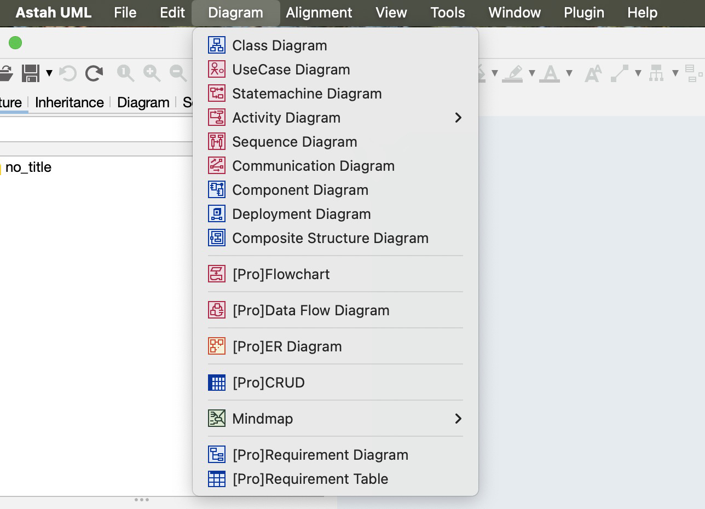
Creating a new Project/Diagram
Open Astah.
Go to File → New Project.
Choose a diagram type (e.g., Class Diagram, Sequence Diagram).
Save the project (.asta file format).

Slide 9
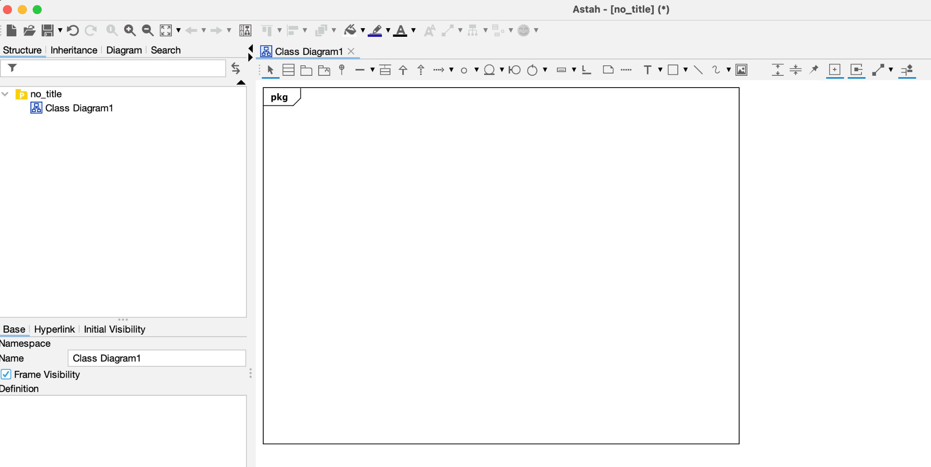
Creating a new Project/Diagram
Astah will create a new diagram in your workspace according to the option you selected.
Now you can add elements to this new diagram by using the toolbar. You can also create new elements by double-clicking on the diagram.

Slide 10
Adding Elements to a Diagram
Drag and drop elements from the toolbar onto the workspace.
Double-click an element to rename or edit properties.
Use the Properties Panel (right-side) to modify attributes like visibility, relationships, and stereotypes.

Slide 11
Connecting Elements
Use Association, Aggregation, or Composition connectors in Class Diagrams.
Use Arrows in Sequence and Activity Diagrams to show interactions. You can connect objects by either hovering near the object and clicking on the line option, then move to another object and click to make the connection. You can also add connections by using the toolbar and selecting the assocat

Slide 12
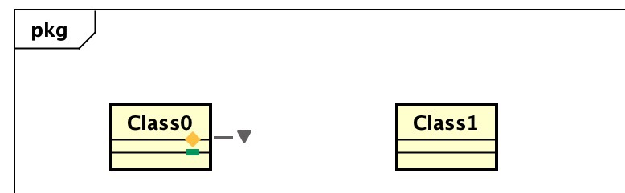
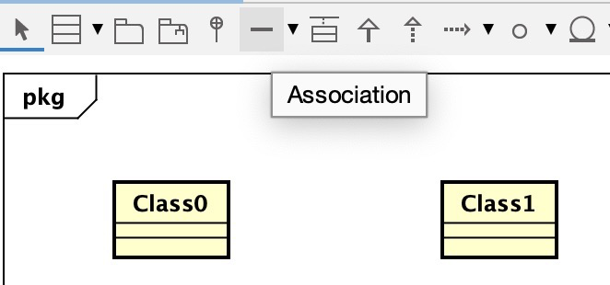
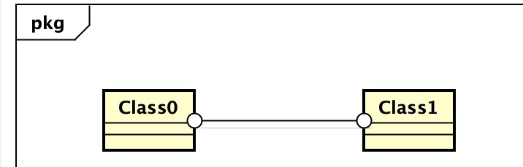
Connecting Elements
Use Association, Aggregation, or Composition connectors in Class Diagrams. Use Arrows in Sequence and Activity Diagrams to show interactions. You can connect objects by either hovering near the object and clicking on the line option, then move to another object and click to make the connection. You can also add connections by using the toolbar and selecting the connection (association, message) option and clicking on objects to connect them.

Slide 13
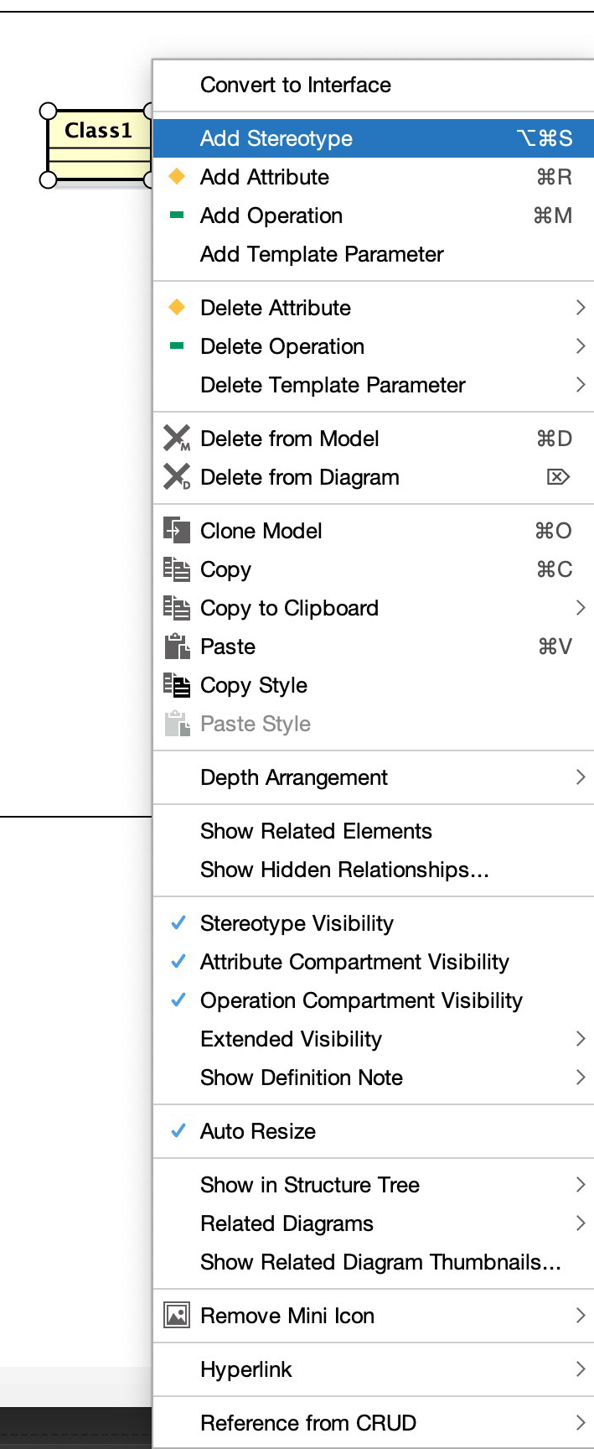
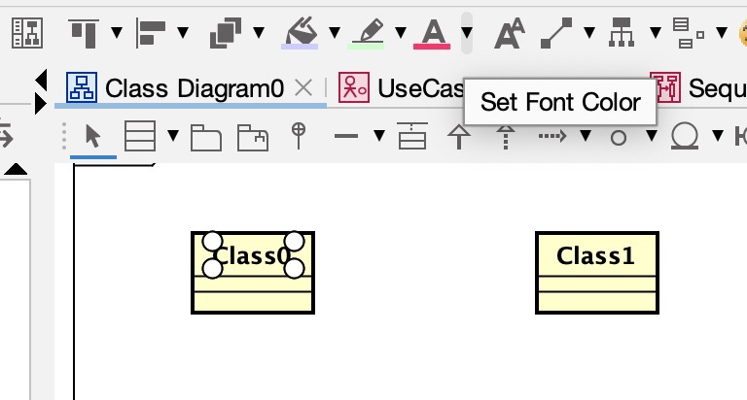
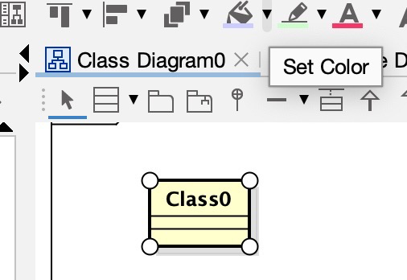
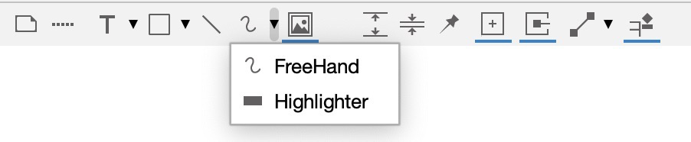
Customizing Diagrams
Right-click on elements to change styles. Click on text or objects to change their color and font using the tool bar.
Use the Color Settings to highlight important parts.

Slide 14
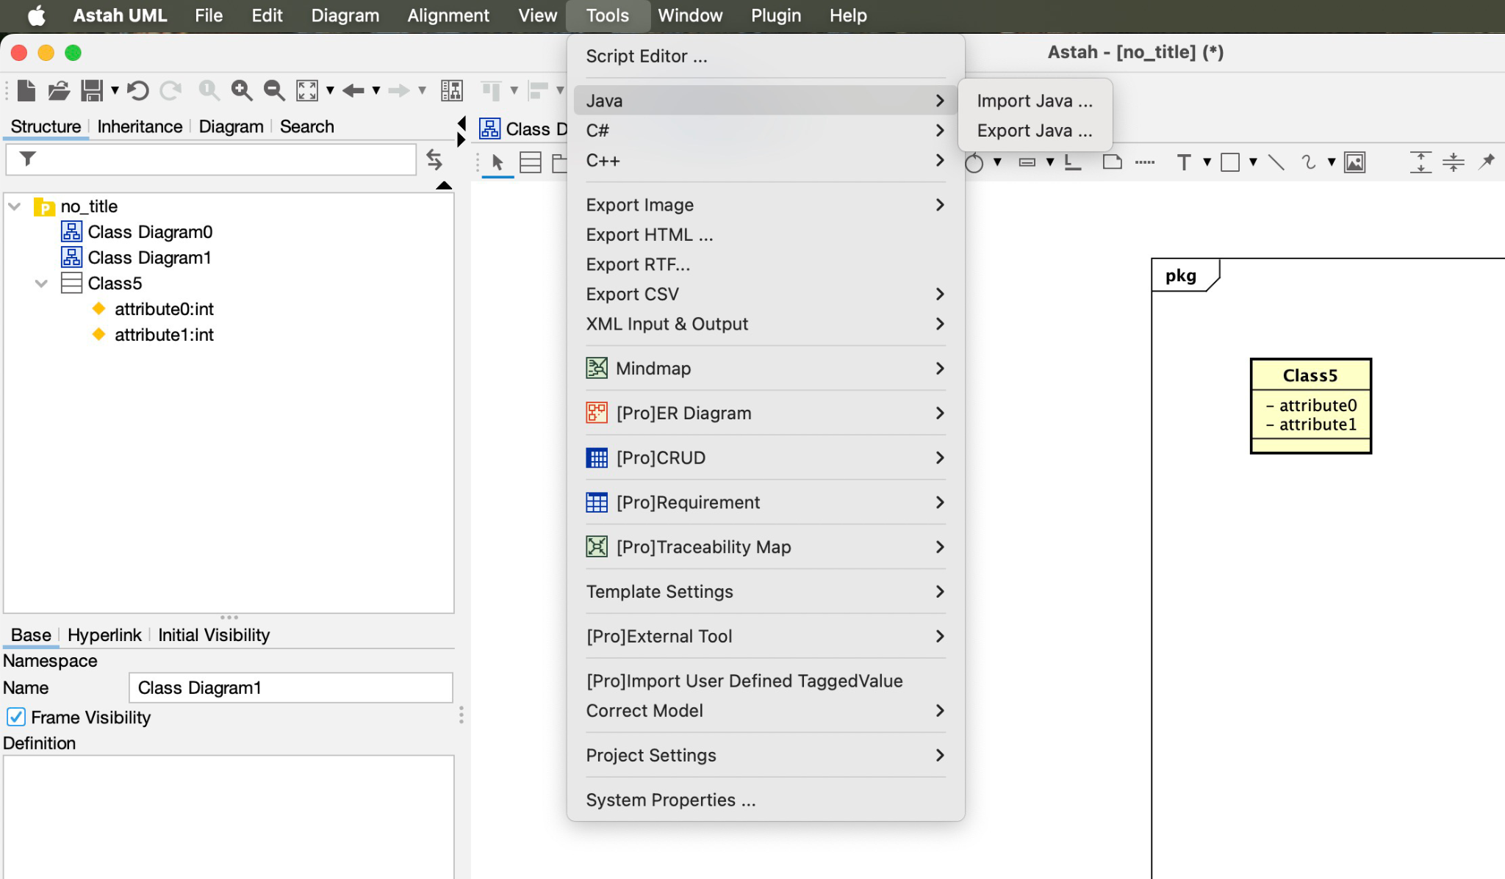
Code Generation
Astah supports Java, C++, and C# code generation from Class Diagrams:
Create a Class Diagram.
Go to Tools → Java → Export Java Source Code.

Slide 15
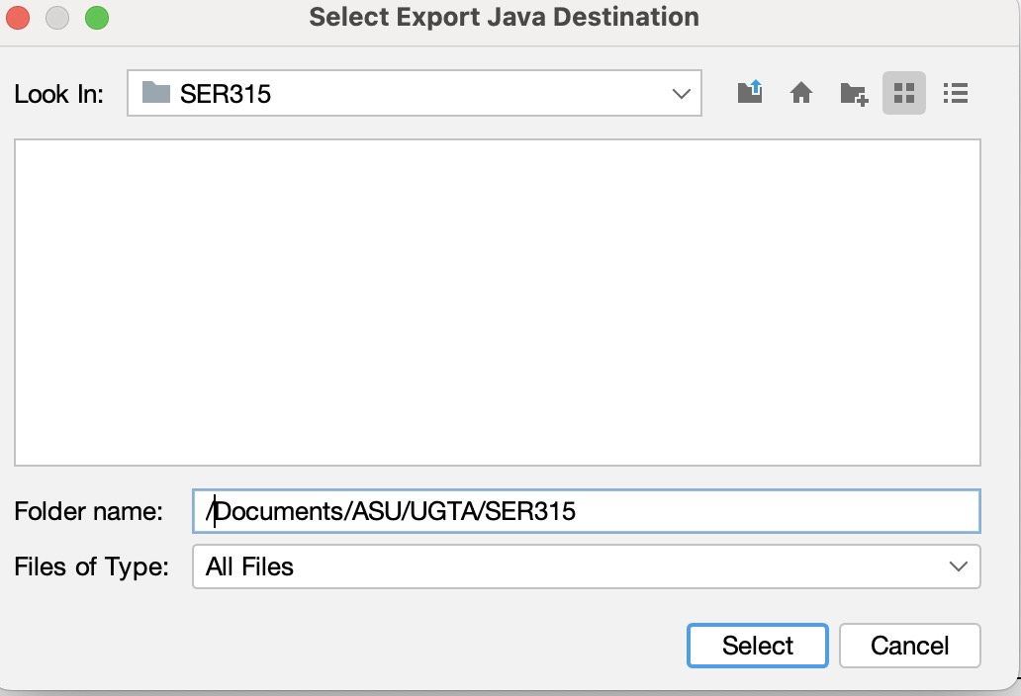
Code Generation
Save the .java files by selecting the folder you would like to save the files in.

Slide 16
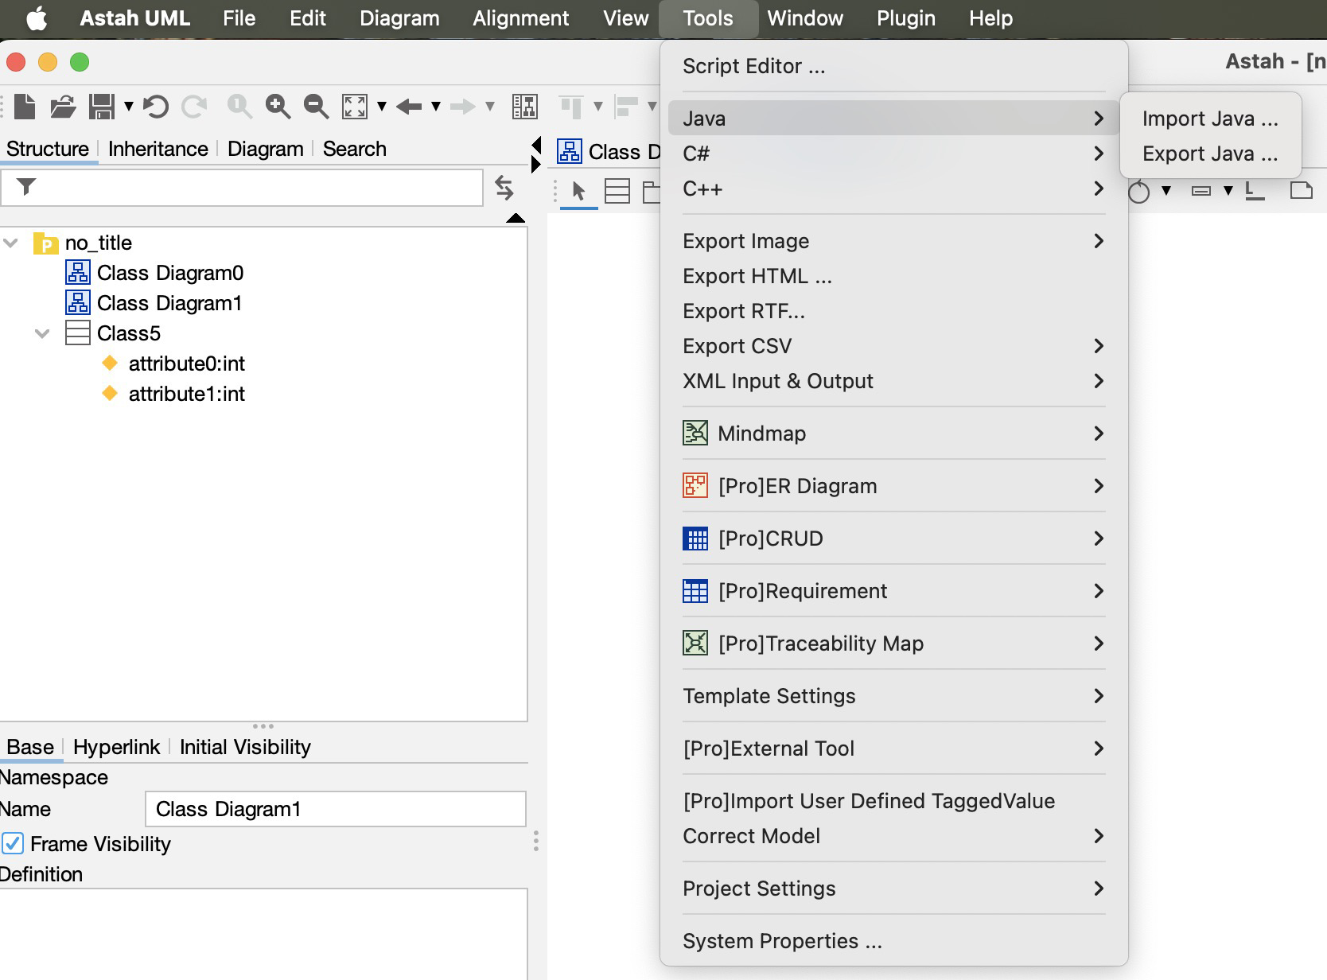
Reverse Engineering Code
You can import Java source code into Astah to generate UML diagrams:
Go to Tools → Java → Import Java Source Code.

Slide 17
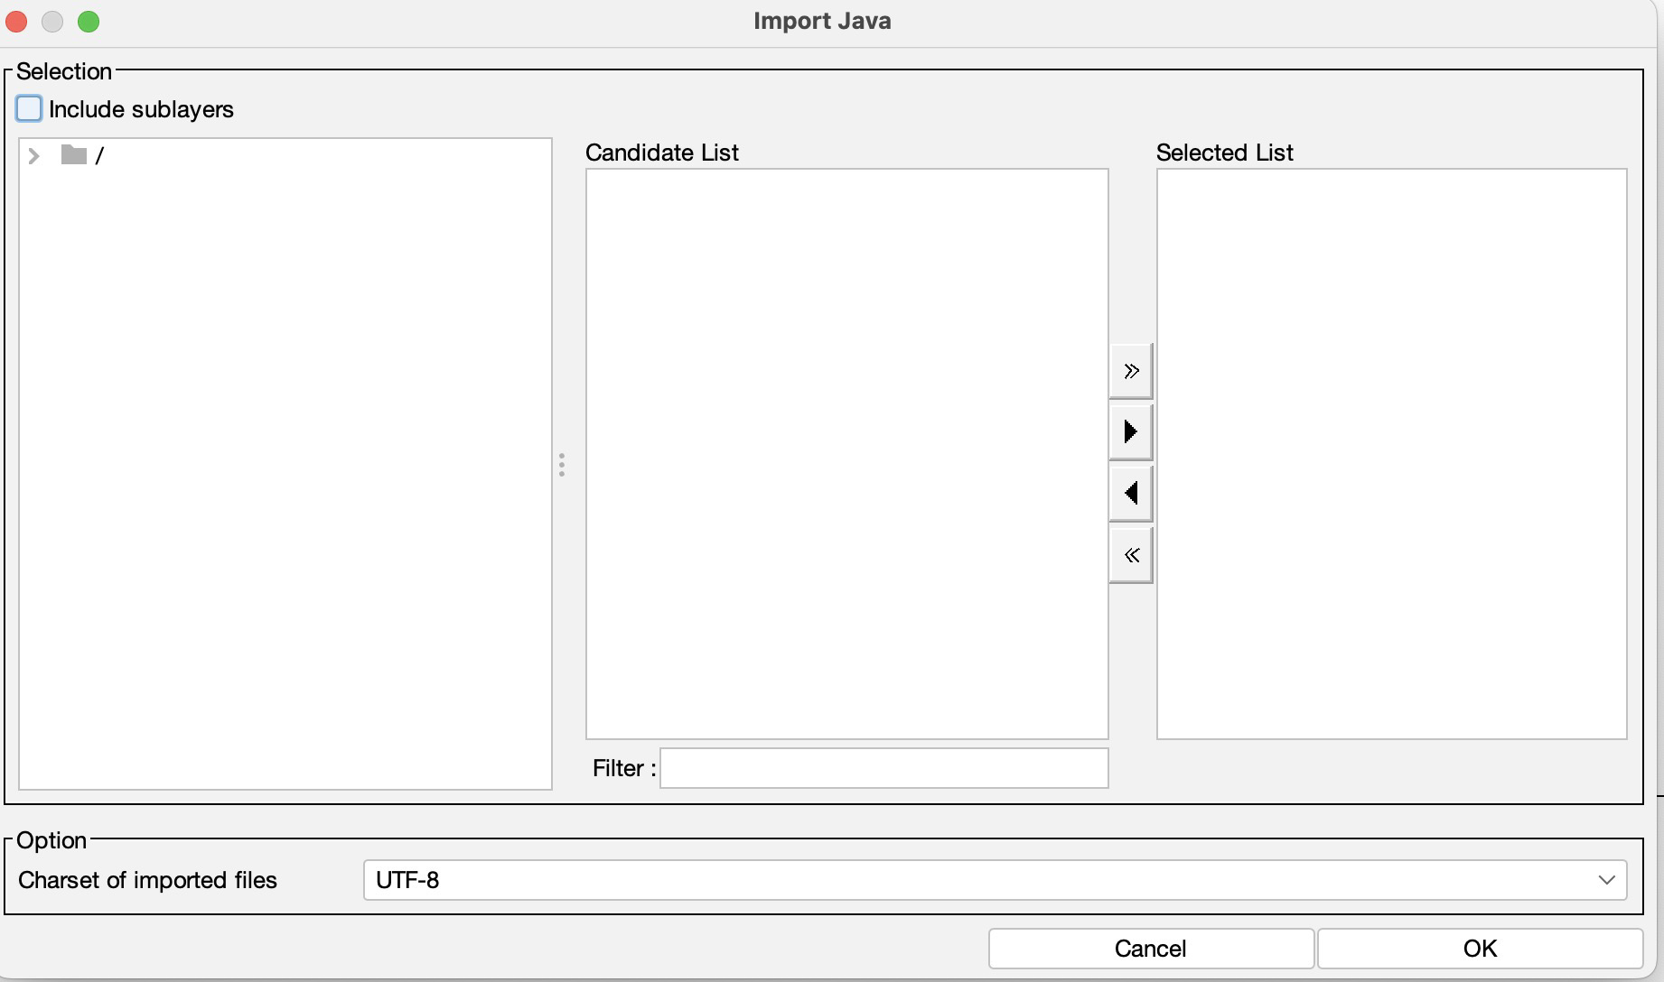
Reverse Engineering Code
Select your .java files to generate from.
Astah will generate corresponding UML diagrams. Note: some associations or properties may not transfer over, so make sure to check that the generated diagram has everything you need.

Slide 18
Astah Plugins
Astah has a plugin system that adds functionality such as:
Easy Code Reverse Plugin (dragging and dropping java files into Astah)
SysML Plugin (for systems engineering)
Mind Map Plugin (for brainstorming)
Code Synchronization Plugins (for keeping UML and code in sync)
To download a Plugin:
Locate the plugin you want to install on the Astah website or the developer's page.
Download the plugin file, (should be a .jar file).

Slide 19
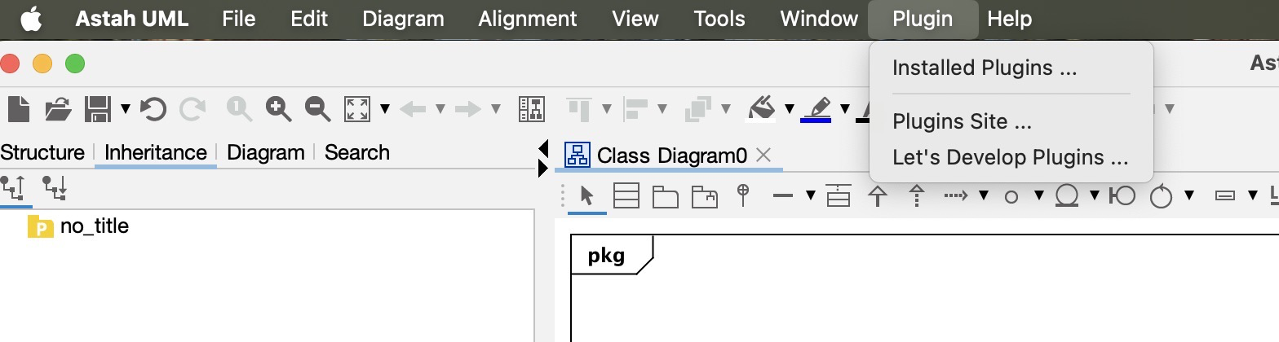
Astah Plugins
Install the Plugin:
Open Astah
Go to: "Plugin" -> "Installed Plugins".

Slide 20
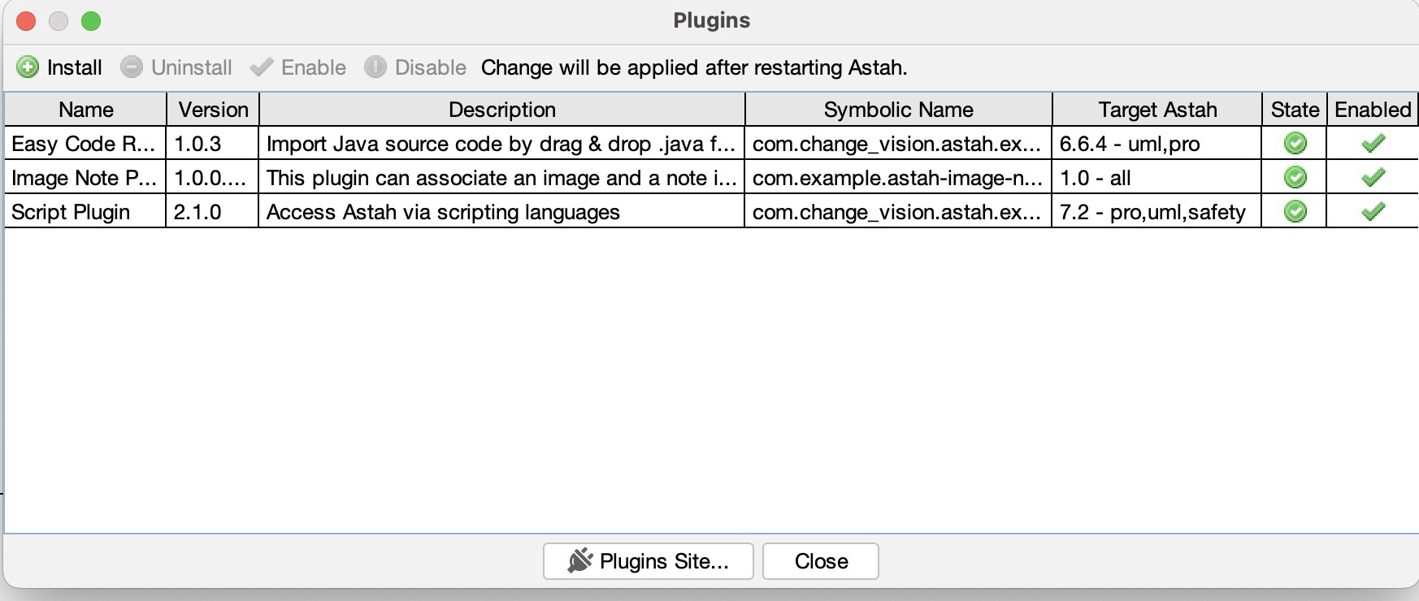
Astah Plugins
Click Install: In the "Installed Plugins" dialog box, click the "Install" button (top left corner).

Slide 21
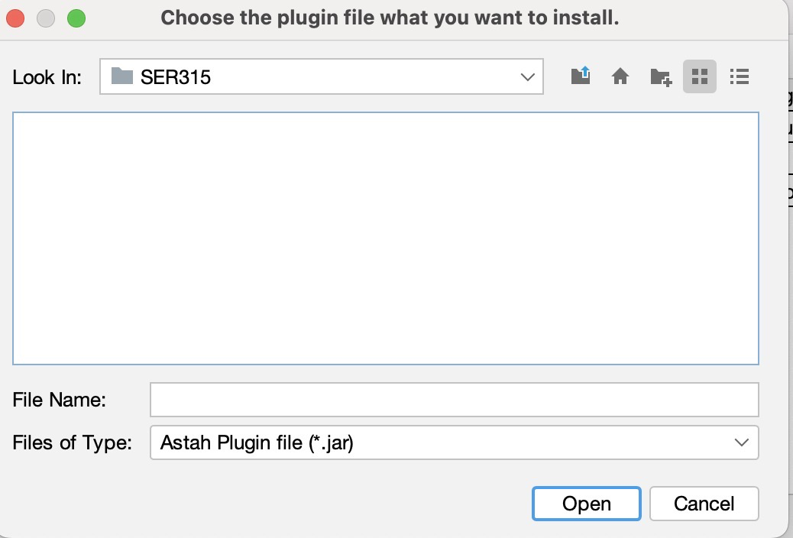
Astah Plugins
Select Plugin File: Browse to the location where you downloaded the .jar file and select it.
Confirm Installation: Click "Yes" if prompted to confirm installation.

Slide 22
Astah Plugins
Restart Astah to complete the installation.
Verify Installation:
Check for the Plugin:
After restarting Astah, check for the plugin's in the Astah interface.
Look for a new tab or feature:
Depending on the plugin, you might see a new tab beneath the diagram editor, a new menu option, or a new feature in the application

Slide 23
Common Questions/Issues

Slide 24
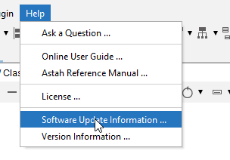
Drag and drop java files into Astah
Some people have had issues when trying to drag and drop java files into Astah.
Make sure the plugin is installed, make sure you have an empty diagram open (i.e Class Diagram), and make sure that there are no non java files selected. https://www.youtube.com/watch?v=_MMiU7M0qAk
Go to Help > Software Update Information to see this information.

Slide 25
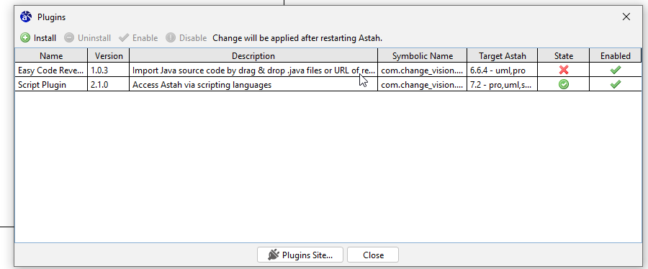
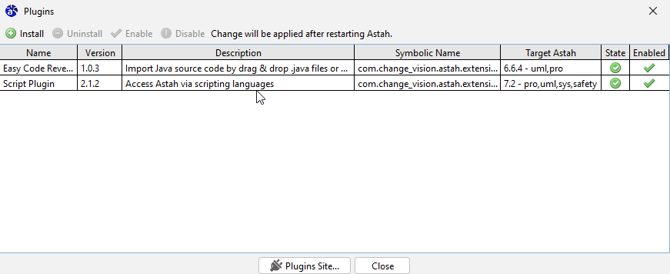
Drag and drop java files into Astah
If the state of your plugin is a red x, try upgrading to a newer version and see if that updates the state of the plugin.
Make sure to check the state of the “Easy Code Reverse” plugin and ensure that it has a green checkmark. Notes: When you drag and drop java files into Astah, there may only be generalizations that transfer over. You may be missing some associations. Check if the current version of your plugin supports “create Associations in Class Diagram". Astah requires Java 8 or higher. If you are having issues or experience crashes, make sure to update your Java version.

Slide 26
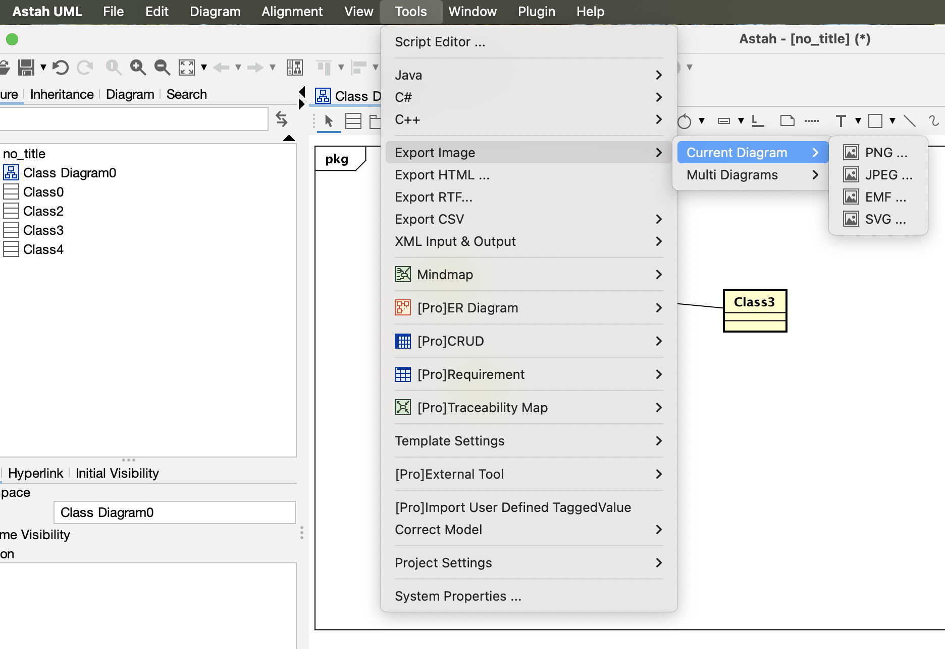
Export Astah file to image
To export an Astah file/diagram to an image, go to Tools > Export Image > Current Diagram and then select the image format you would like to export to.
Note: If PNG/PDF export fails, try changing file permissions or running Astah as an administrator.

Slide 27
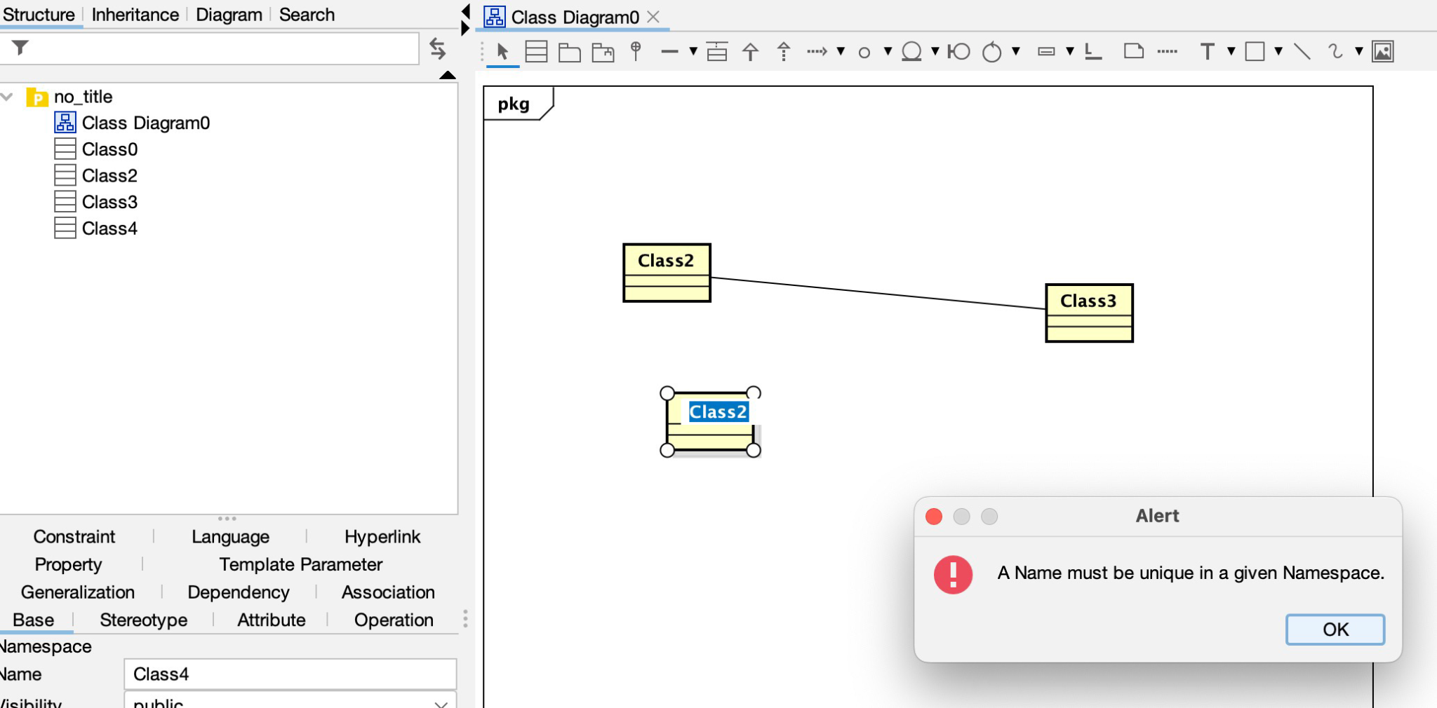
Alert "A Name must be unique in a given Namespace."
https://www.youtube.com/watch?v=fRMQKIG7O50&t=425s
The model folder in Astah contains the model of the software. Thus, if you create an object in one diagram it will be available in all of the other diagrams in your model, including different types of diagrams. You will not be able to create another object with the same name if one already exists.

Slide 28
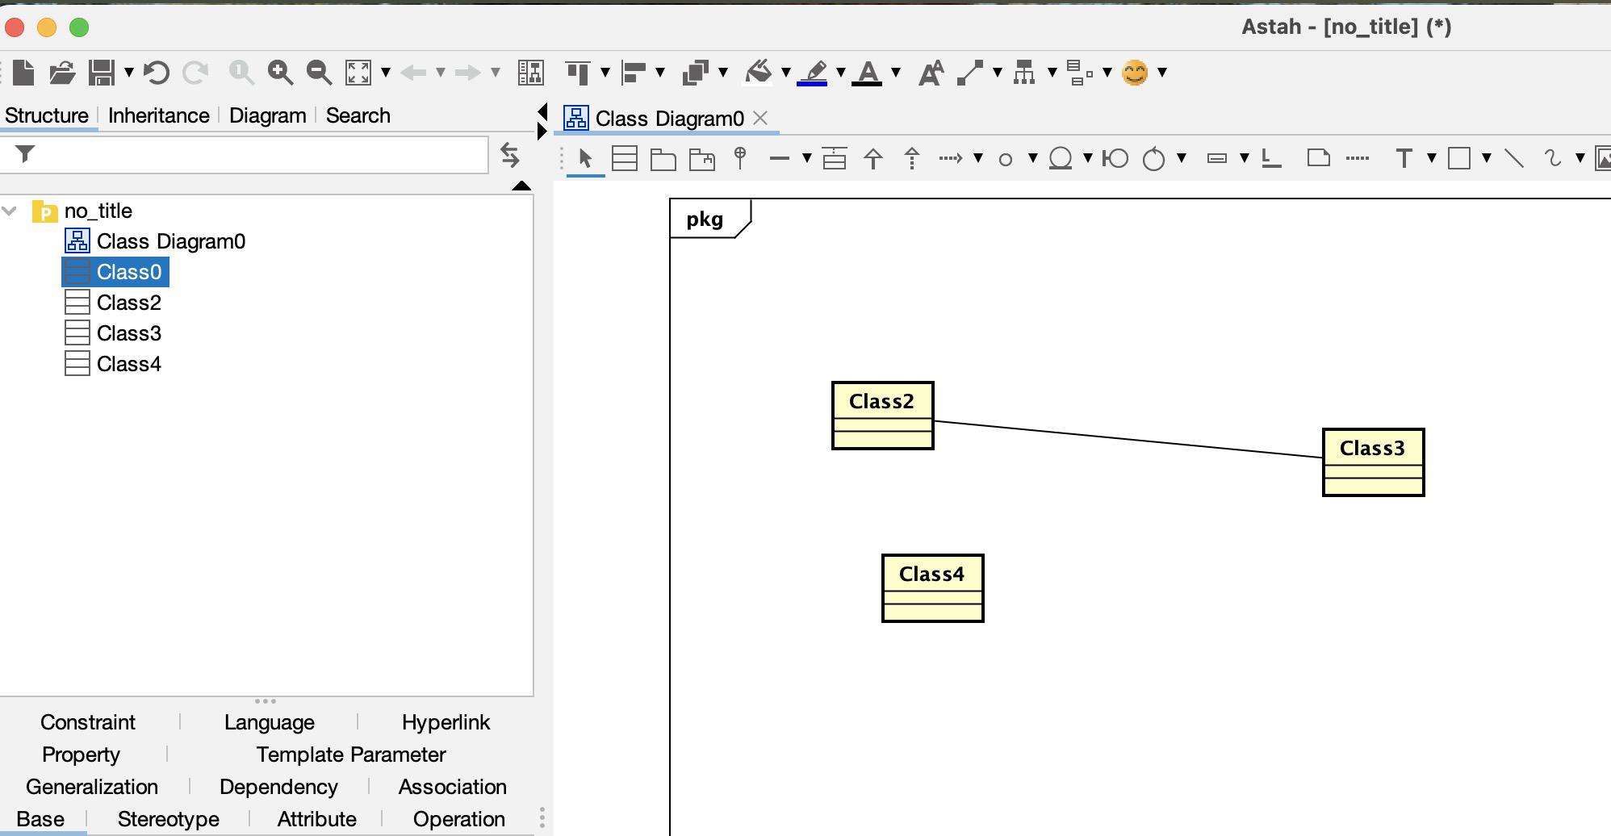
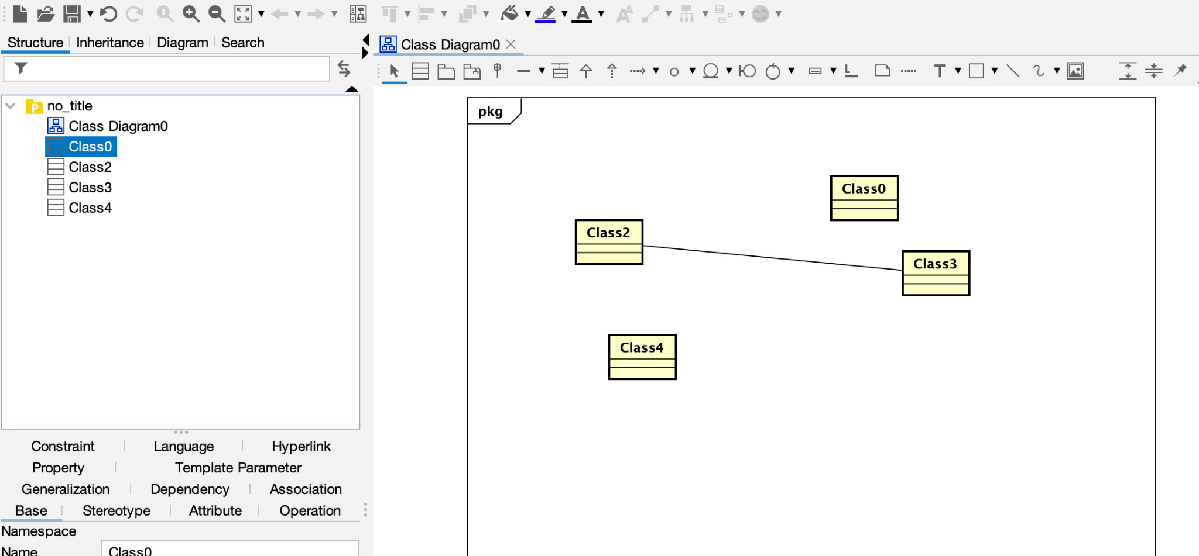
Alert "A Name must be unique in a given Namespace."
If you are trying to refer to the same object, you can simply drag and drop the object from the model side bar into the diagram you need it to be in.

Slide 29
Including Overridden Methods in Subclasses in a Class Diagram
Overridden methods should be included in subclasses.The Class Diagram needs to communicate that the subclass is changing/augmenting the functionality of the parent class. Thus, the overridden methods should be included in the corresponding subclasses.

Slide 30
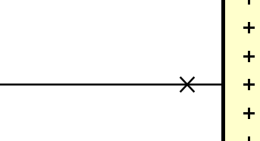
Astah Non-Navigable Symbol
In Astah, this “x” symbol non-navigable. If it sometimes left unspecified, or marked with an “x” symbol. This designates that one class does not know the other class. This is indicating which information that needs to be passed and to which classes.

Slide 31
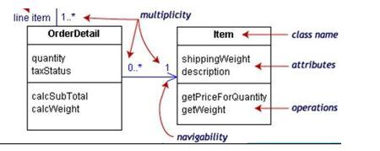
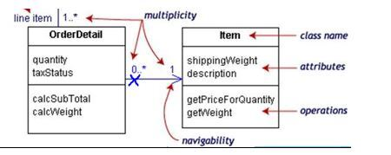
Astah Non-Navigable Symbol
Examples: Order needs to know item, but item doesn’t need to know order

Slide 32
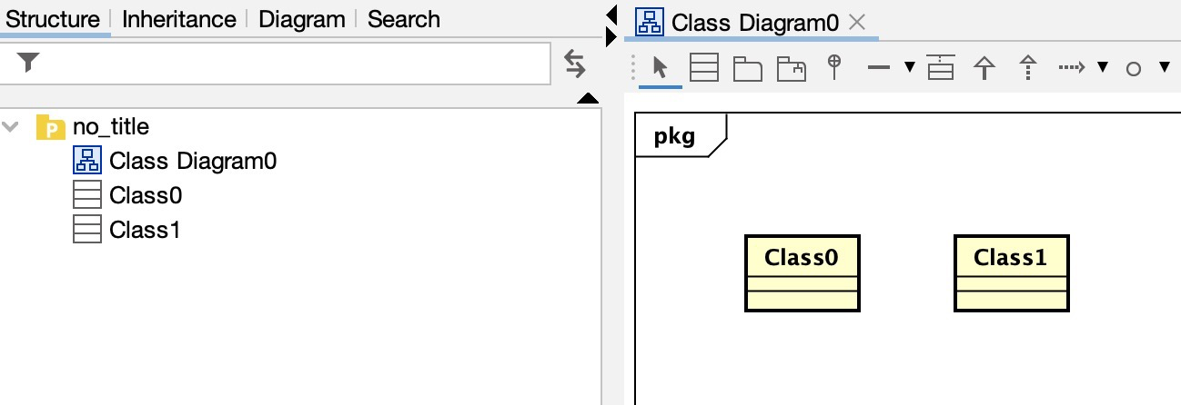
Deleting Attributes/Elements
When deleting elements from a diagram, there are two options.

Slide 33
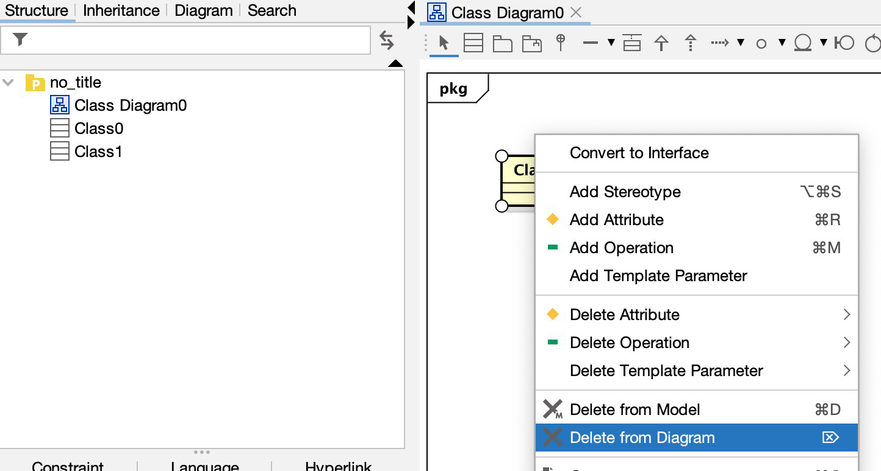
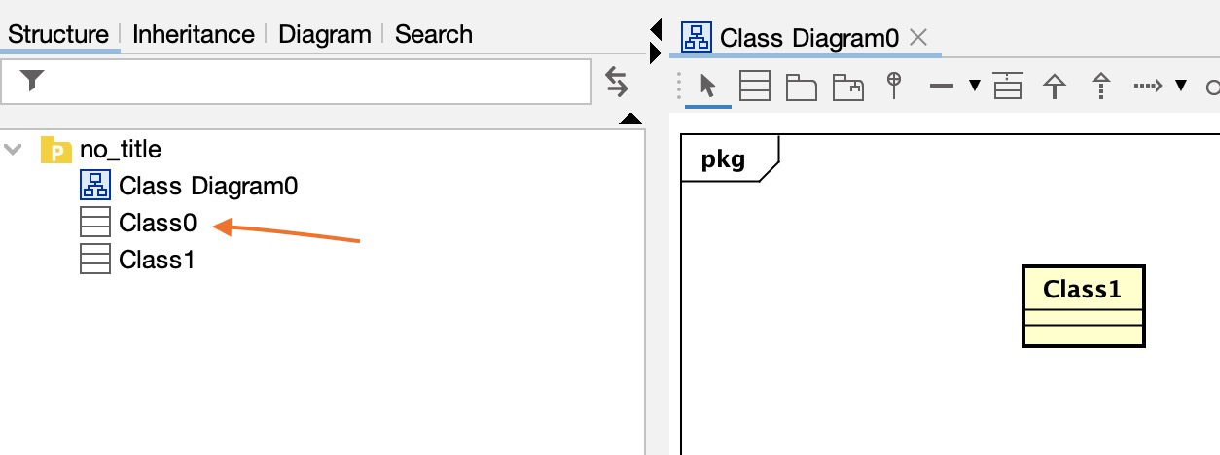
Deleting Attributes/Elements
You can delete the element from the diagram, which only removes it from the view, however it will still remain in the model.

Slide 34
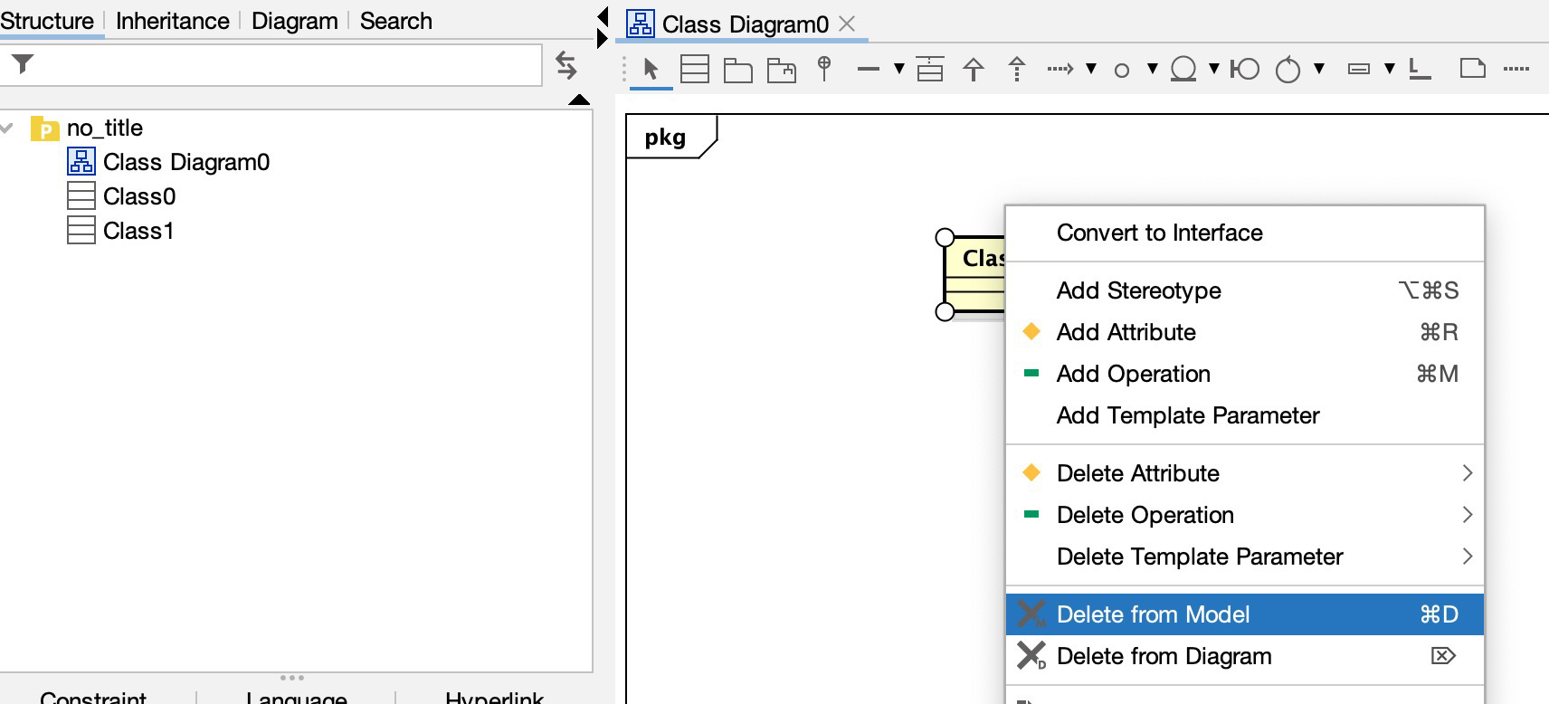
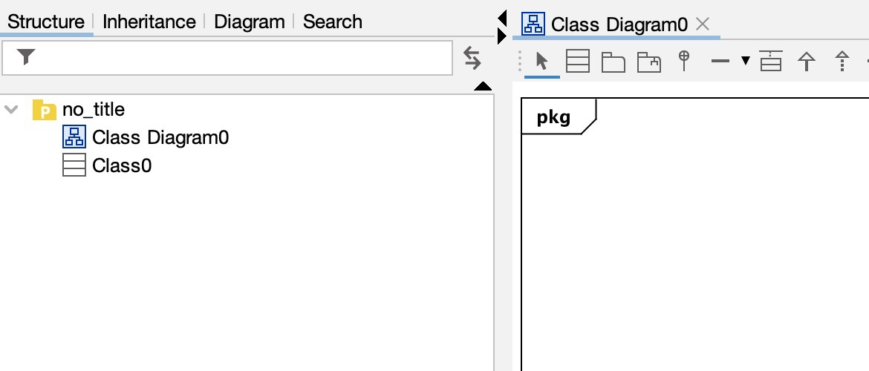
Deleting Attributes/Elements
Secondly, you can delete it from the model, which will completely remove it from the diagram and file.
If you want to completely remove an element from the file, use the “Delete from Model” option. Otherwise, if you just want to remove it from the diagram use the “Delete from Diagram” option.

Slide 35
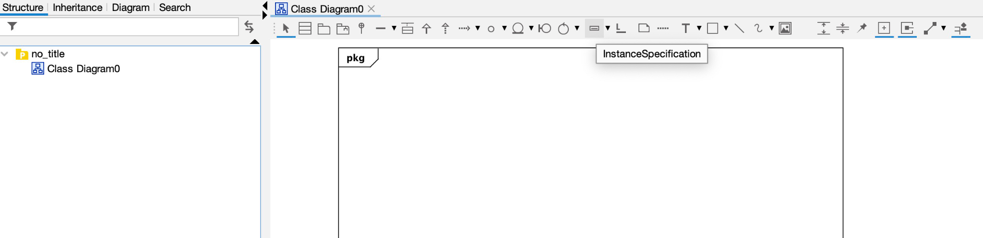
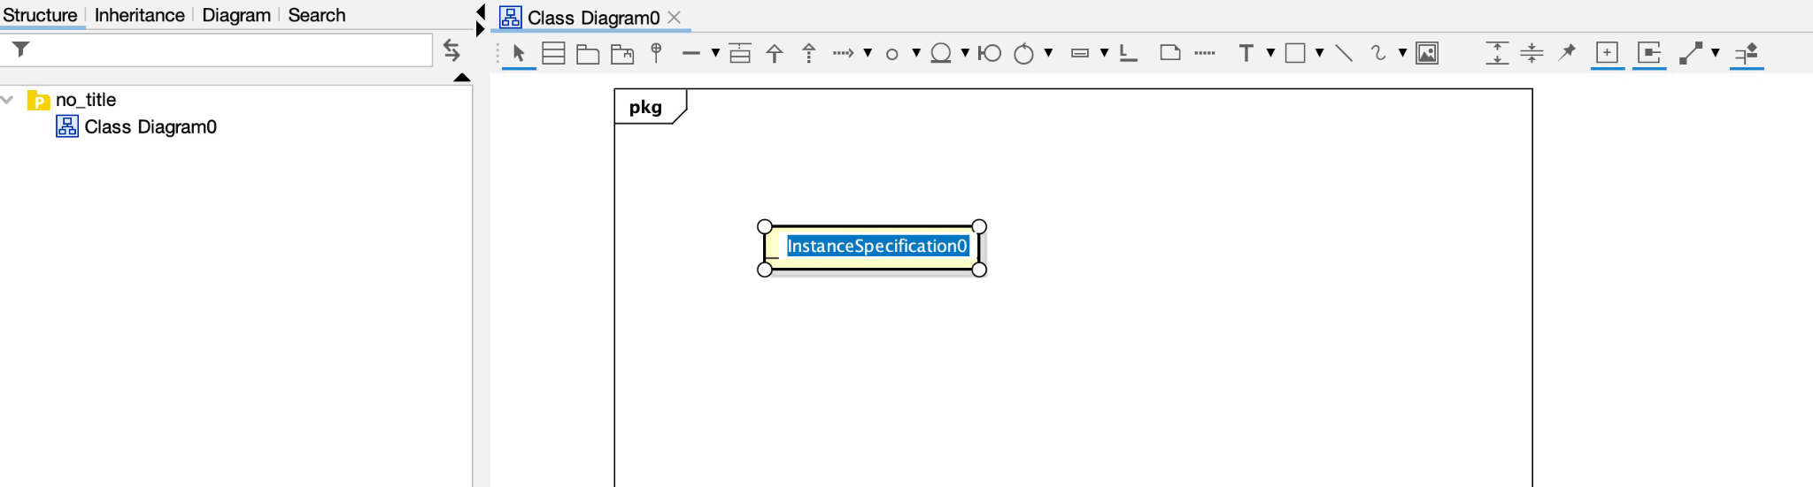
Which diagram to use for Object View
In Astah, you can use a Class Diagram to create an Object View.
Use InstanceSpecification

Slide 36
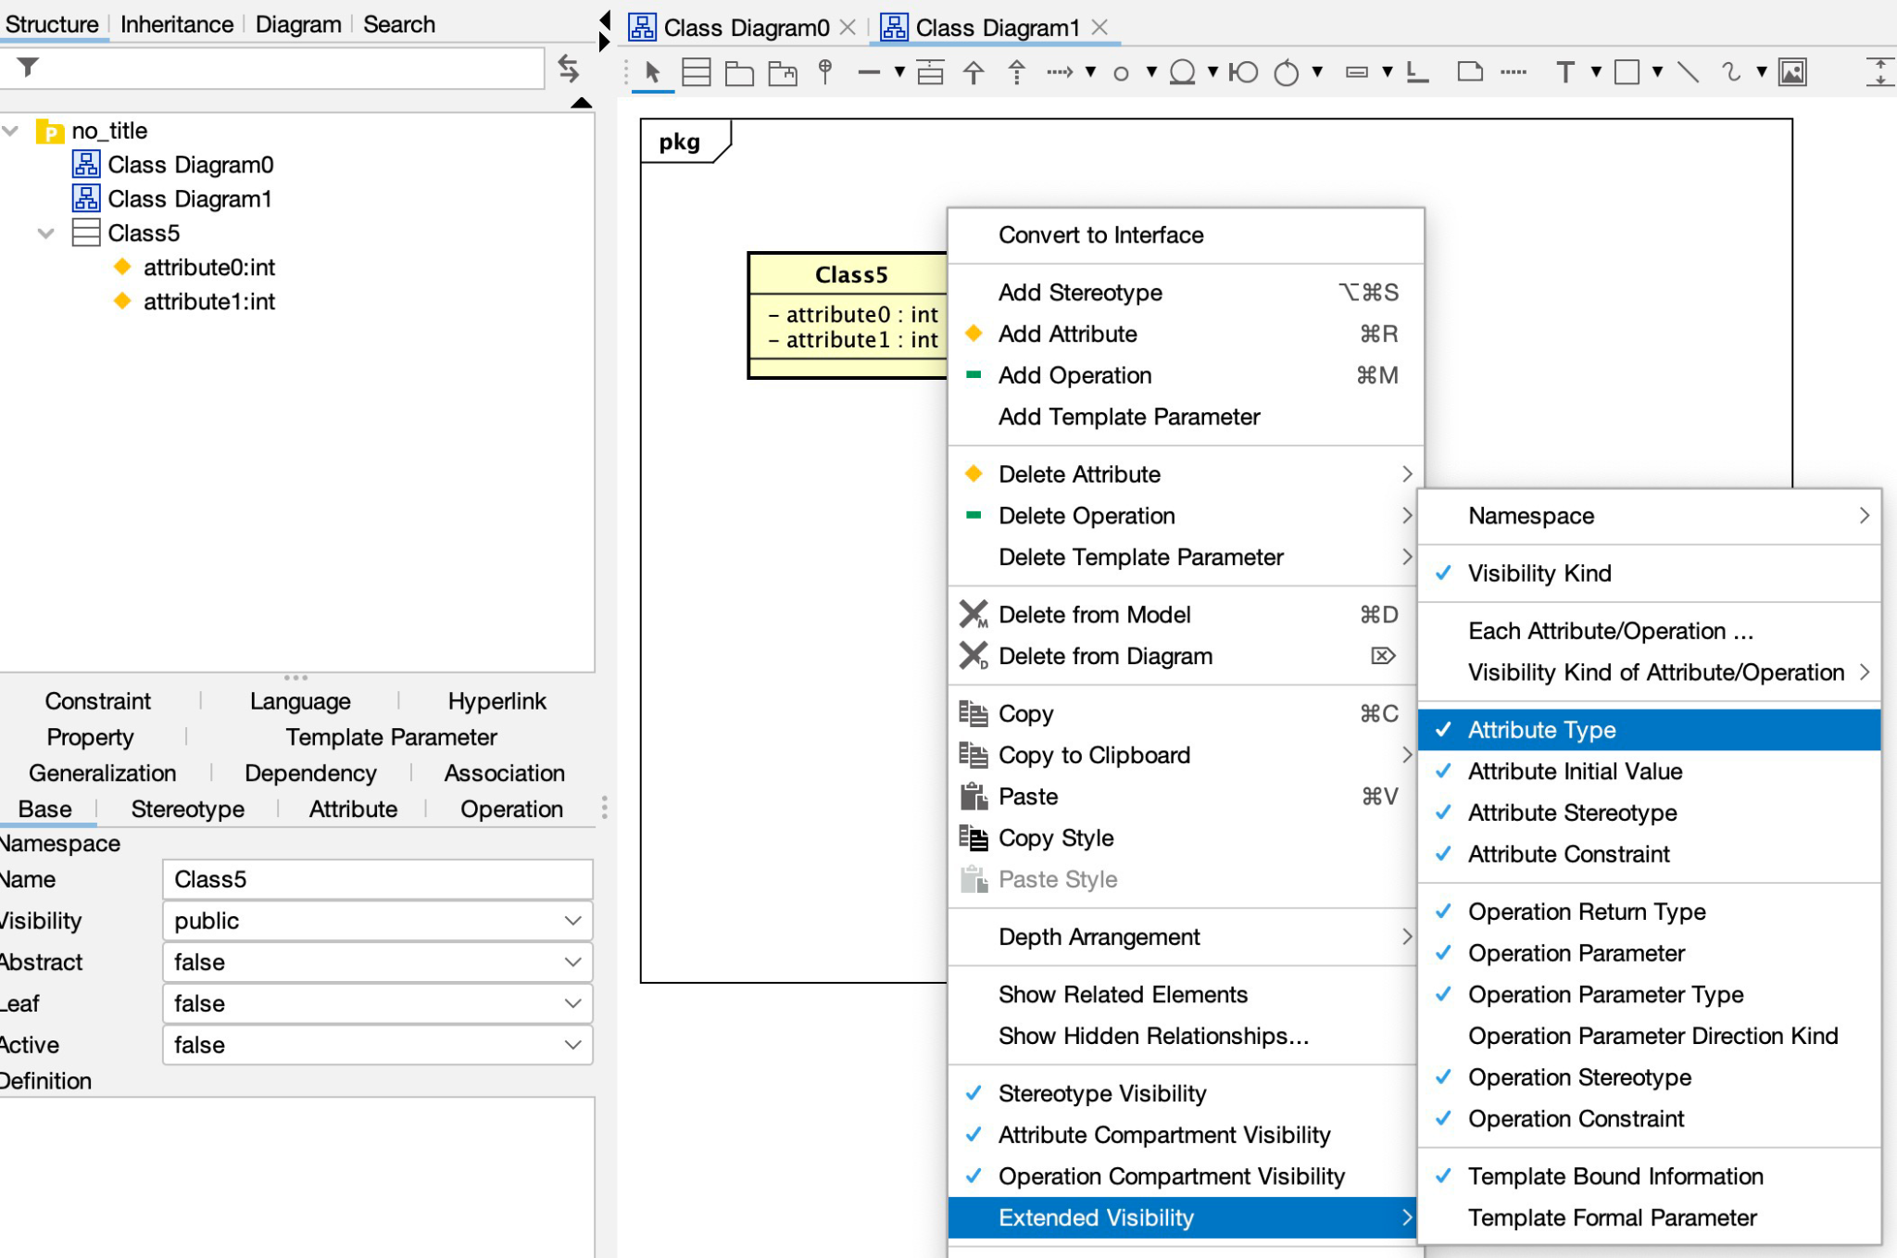
Hide the attribute type in the domain class model
There are several things that can be hidden from the diagram including attribute types. You simply right click on the object then go to Extended Visibility.

Slide 37
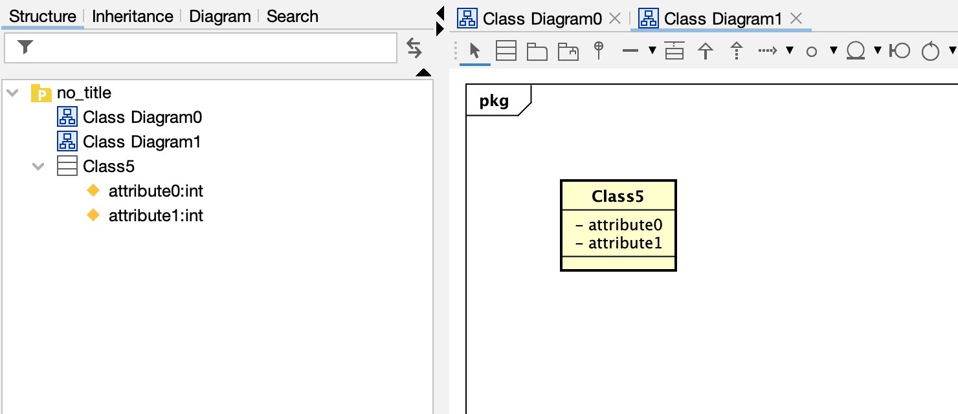
Hide the attribute type in the domain class model
Select the value you would like to hide or unhide and Astah will update your diagram accordingly.

Slide 38
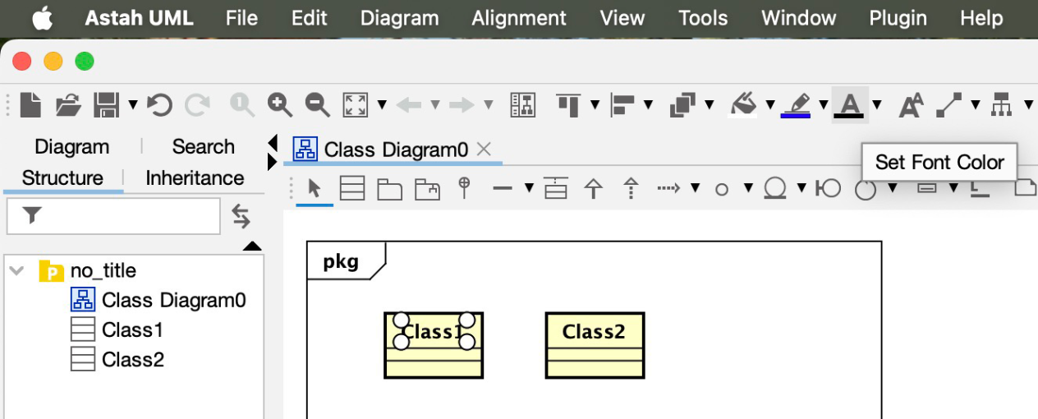
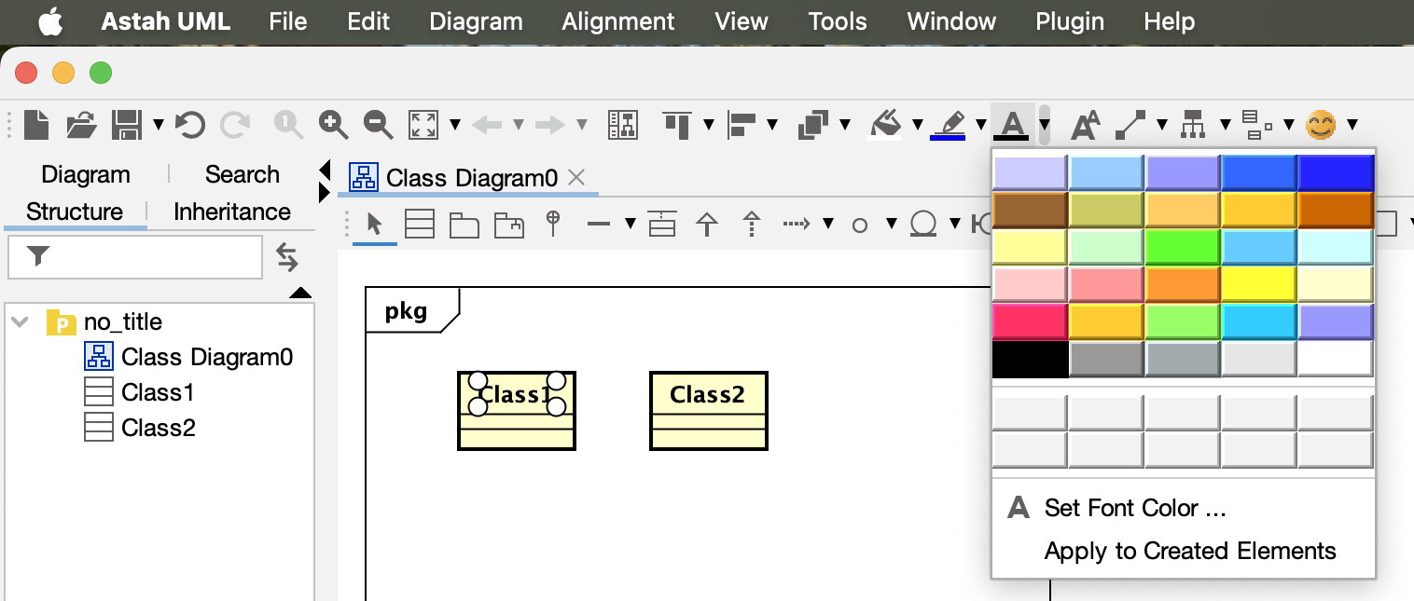
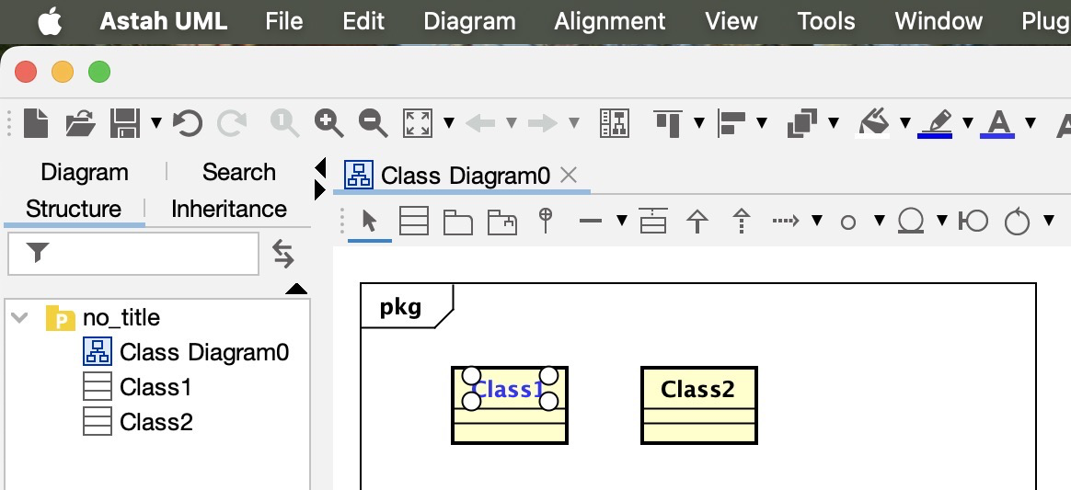
Change Mark text with different color
To change the text color you can click on the title you want to change the color of, then on the toolbar click on the Set Font Color arrow button and choose the color you want. Astah will update the text to the color you chose.

Slide 39
Improve Astah performance
If your Astah software is running slowly, try disabling plugins that you aren’t using or use fewer elements in each of your diagrams.

Slide 40
Deep Dive into Astah Tutorial
ASU UGTA Nicole Garcia

